Slide 1


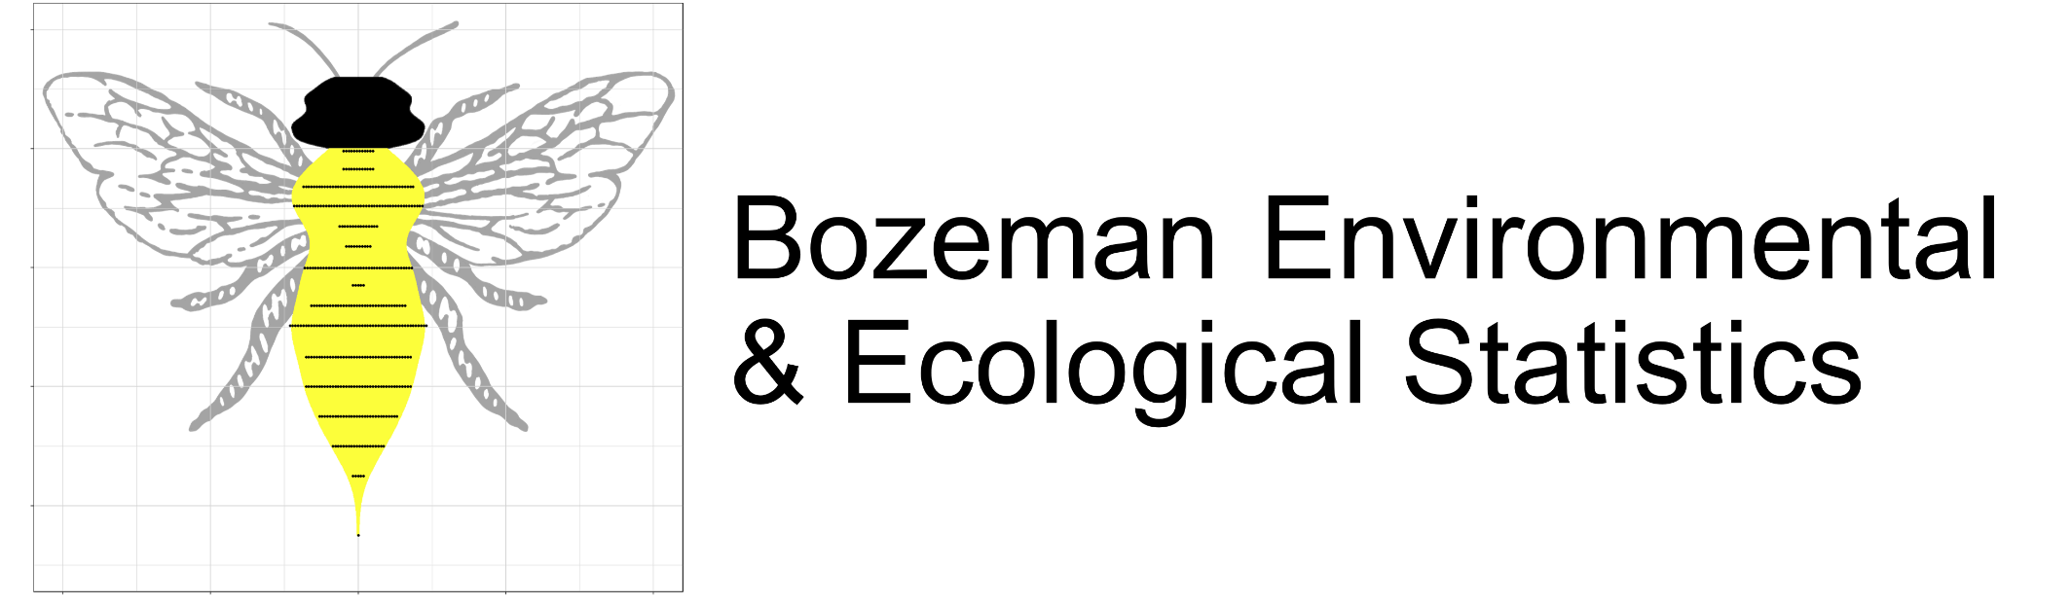
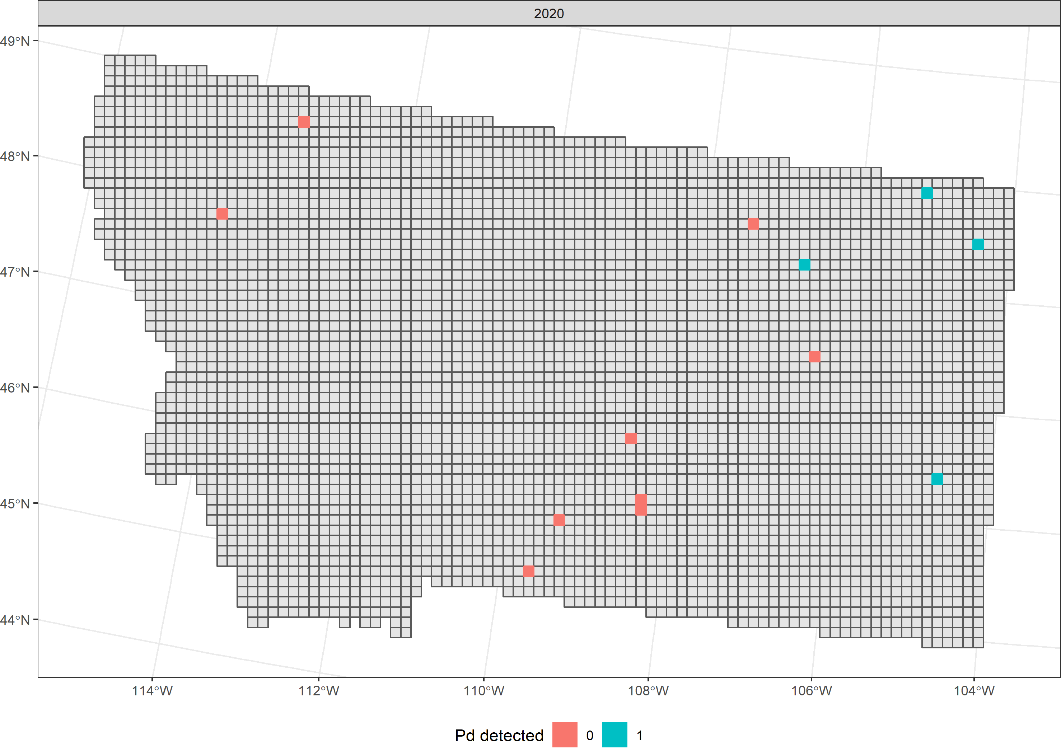
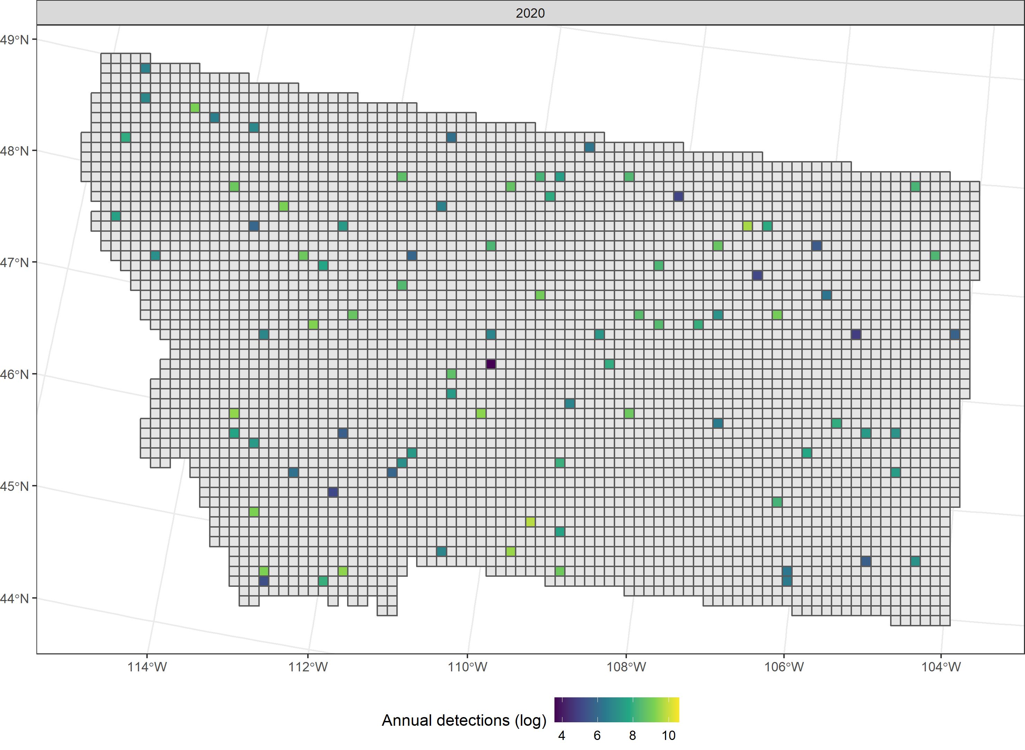
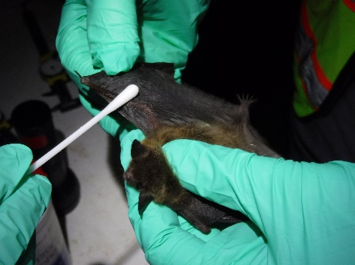
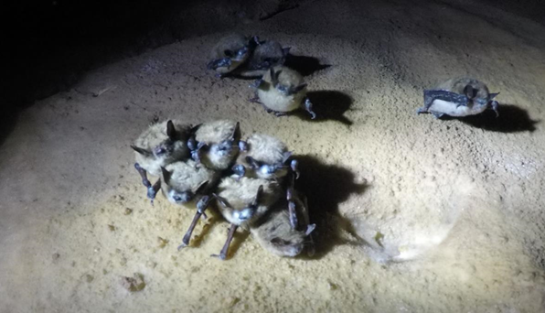
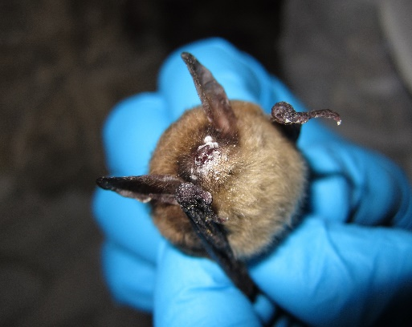
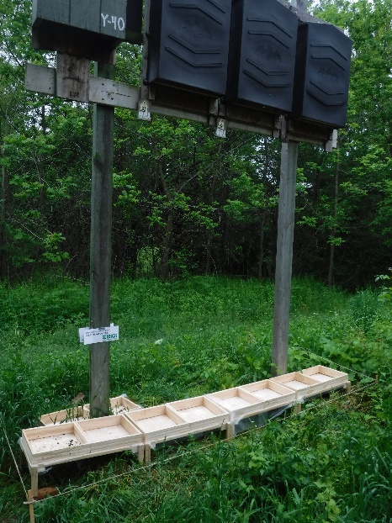
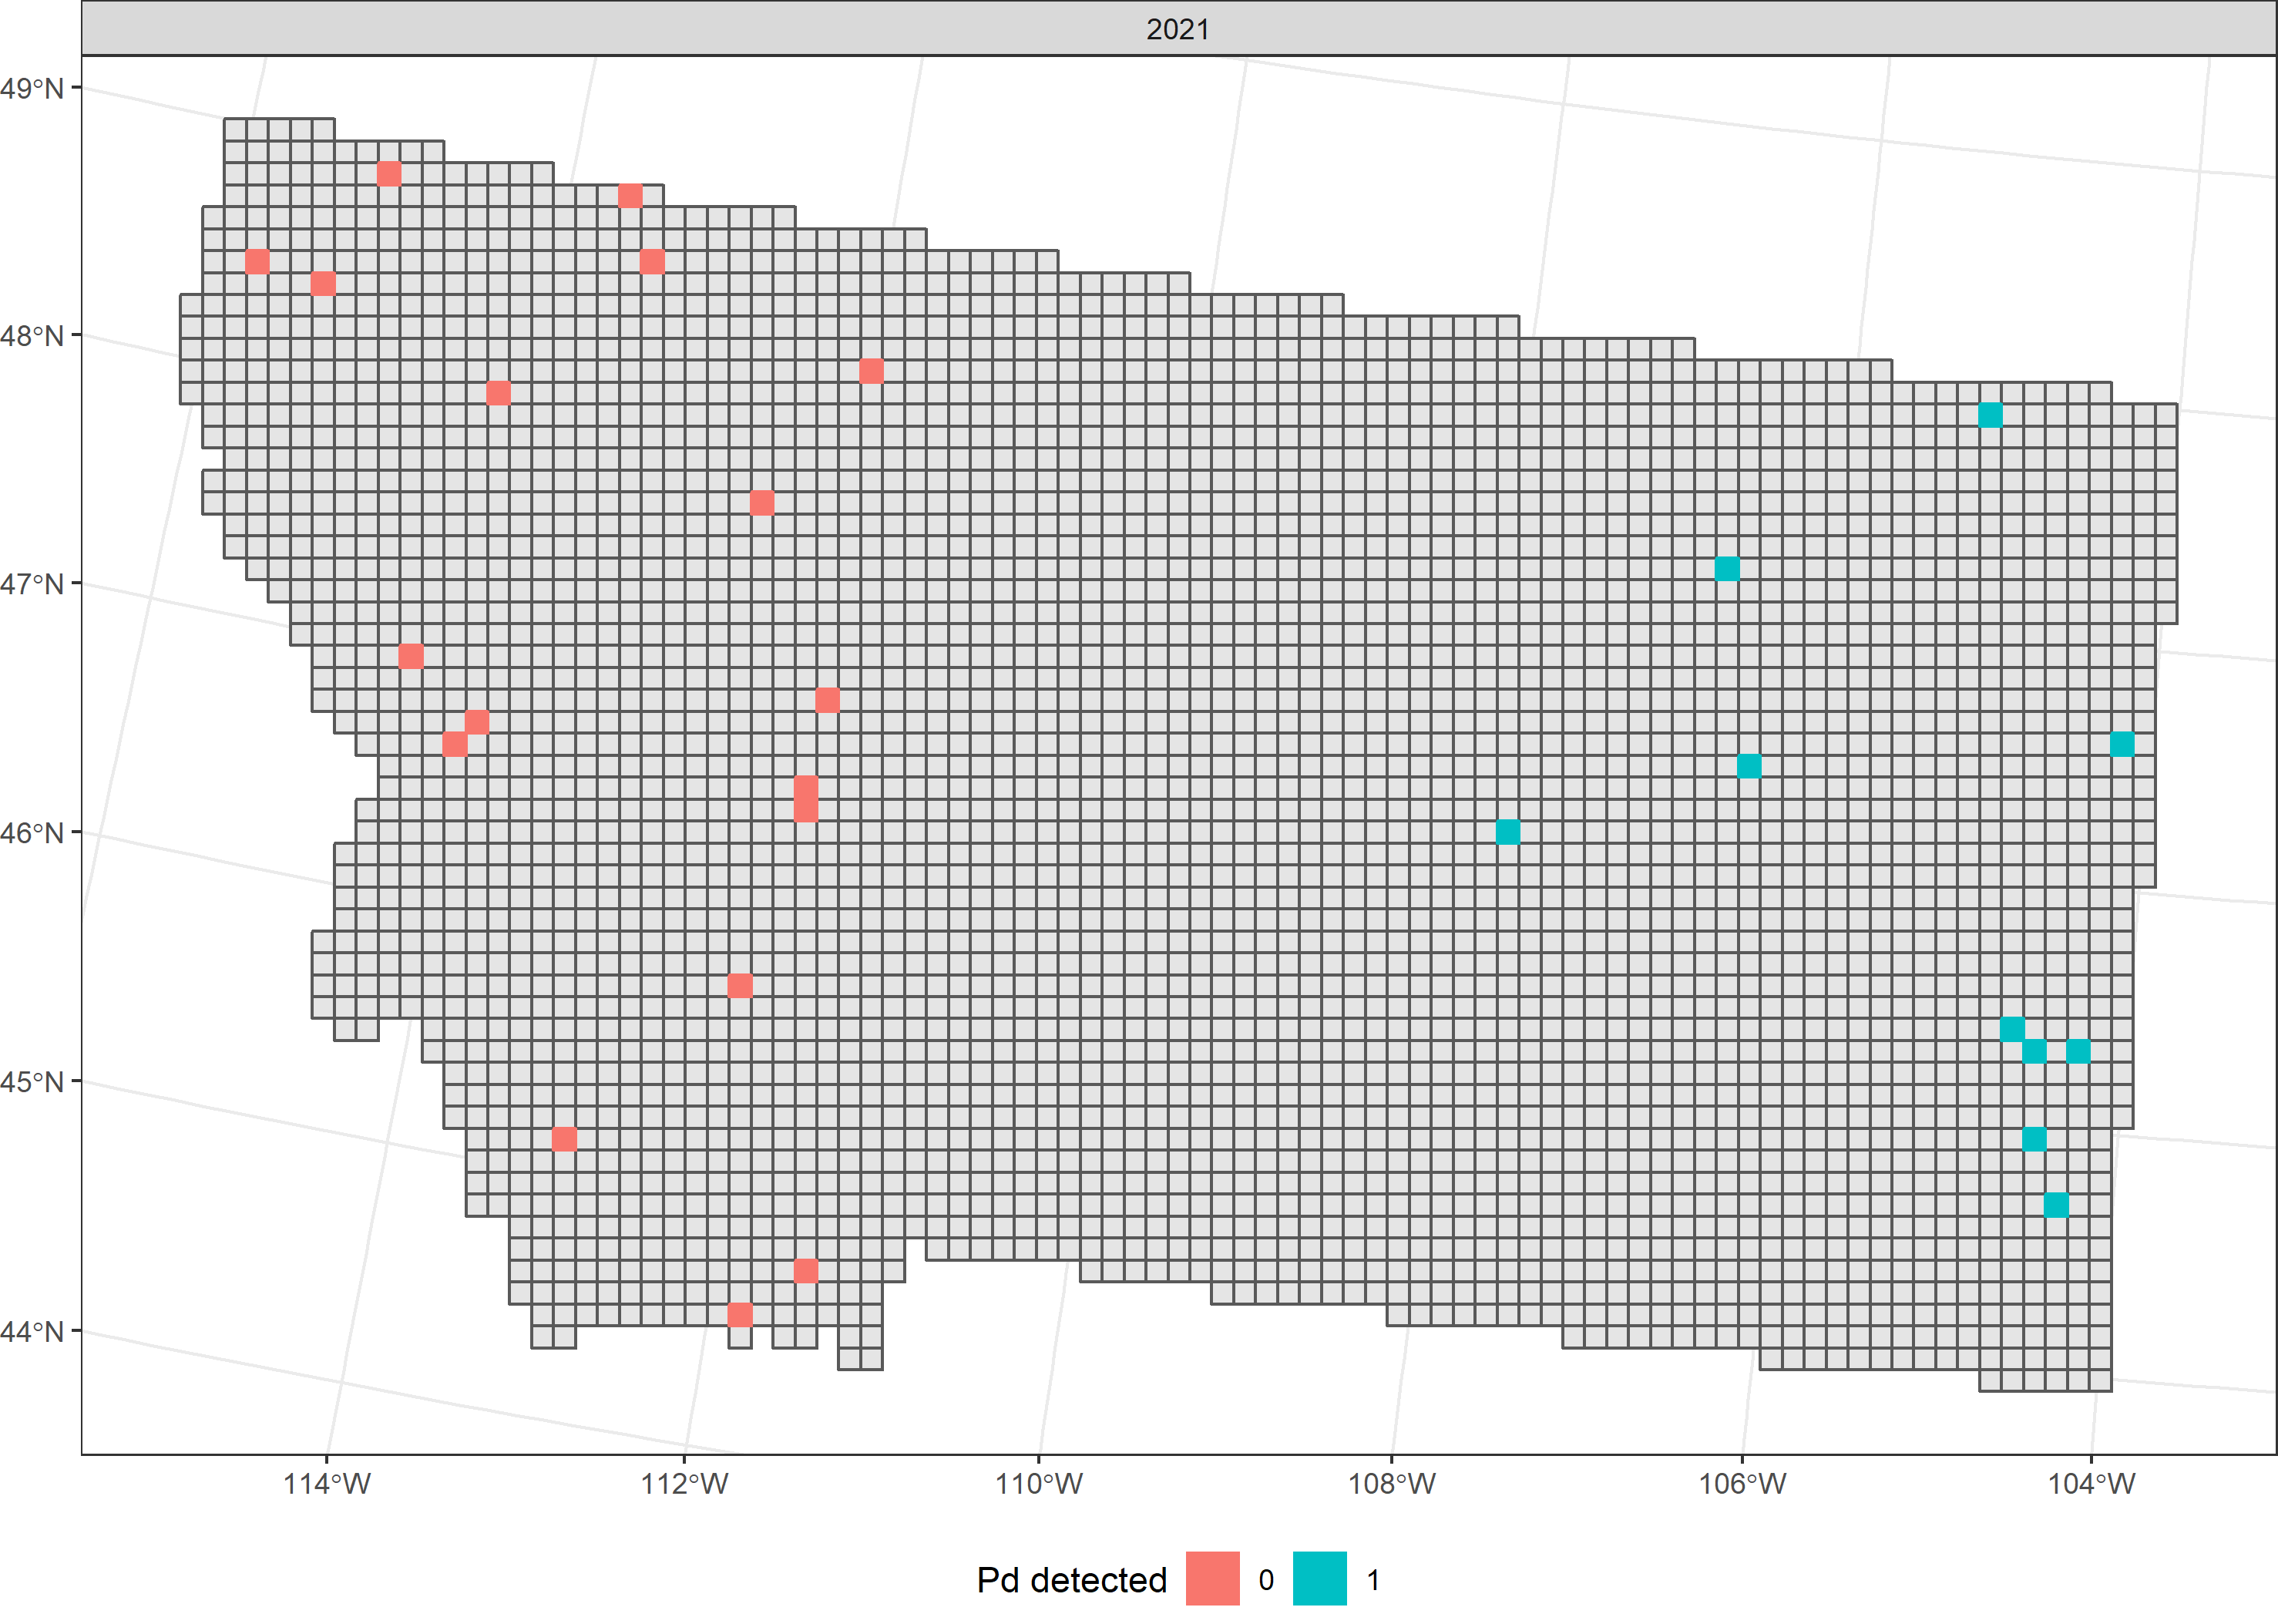
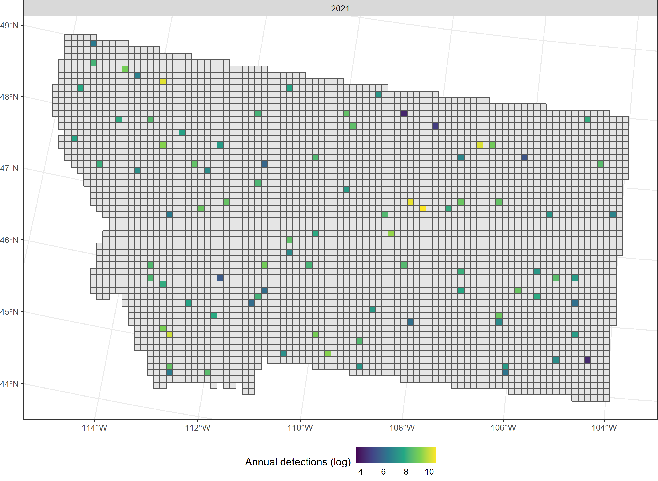
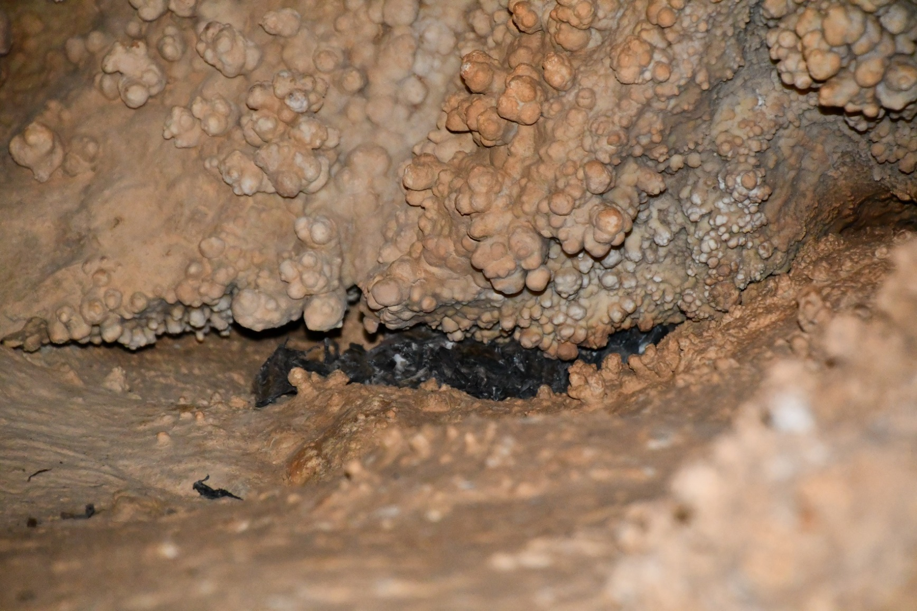
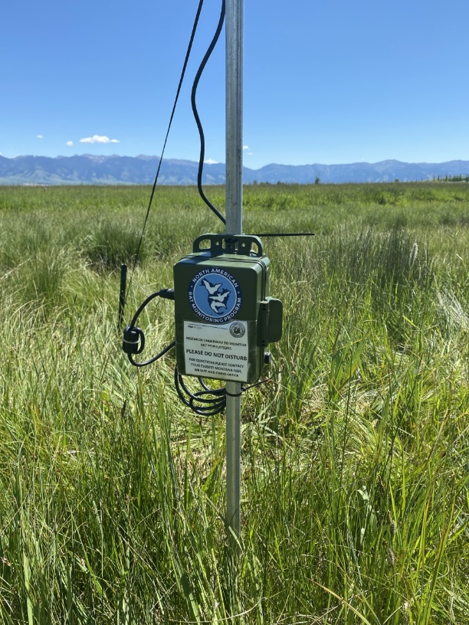
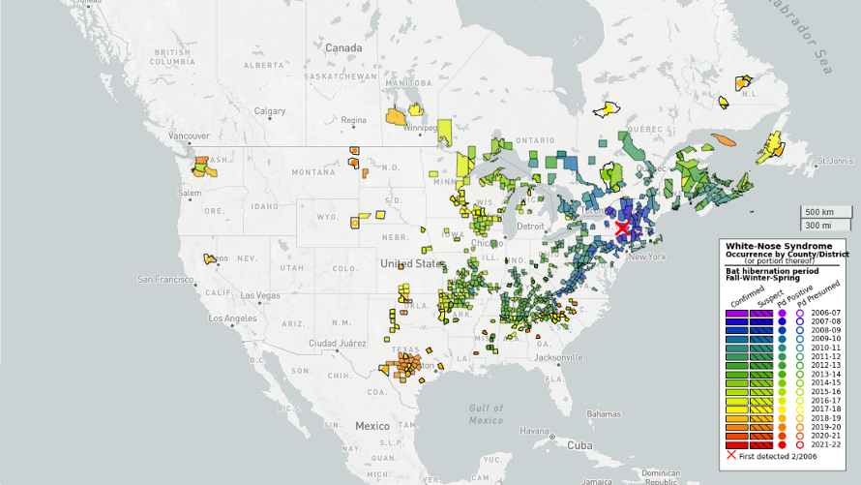
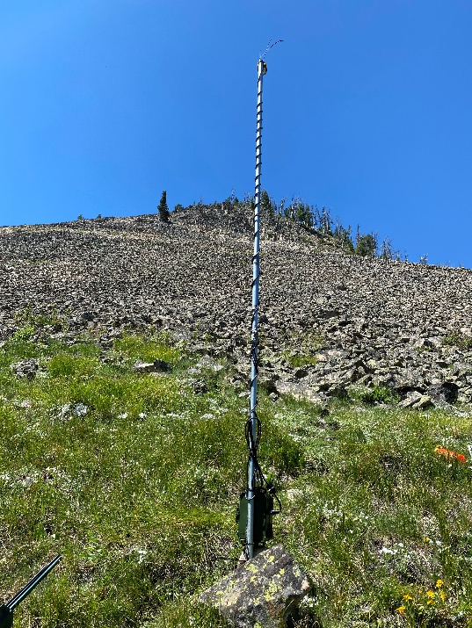
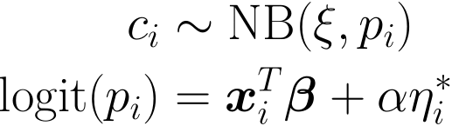
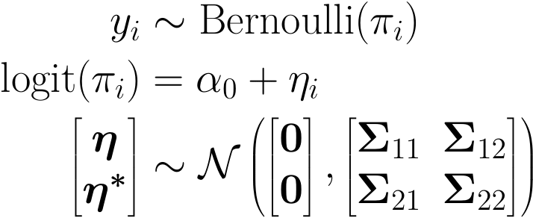
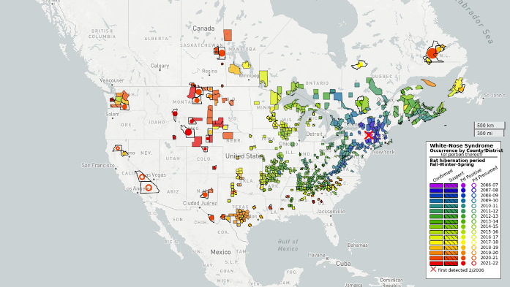

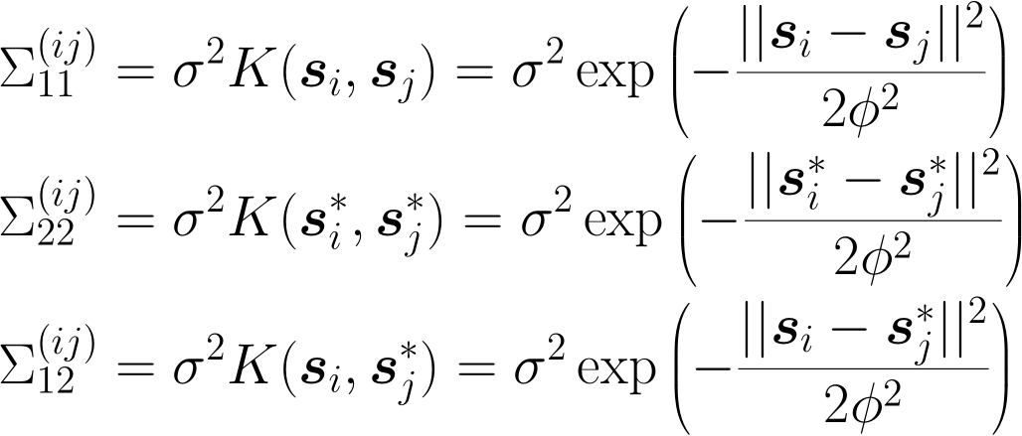
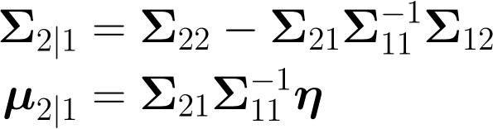
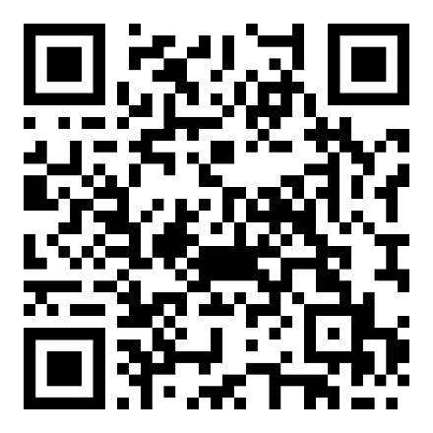
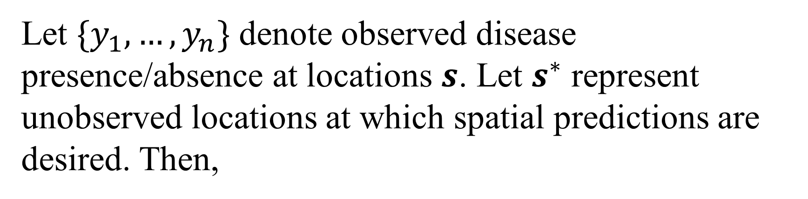
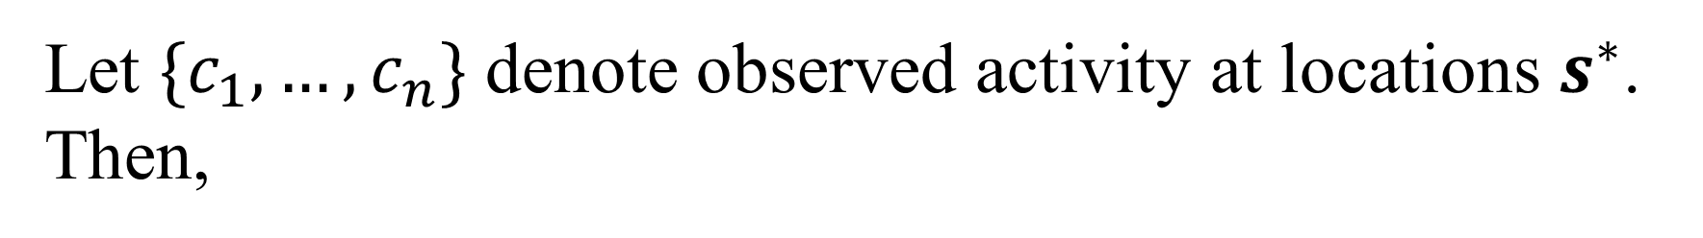
Joint spatial modeling of relative activity and disease processes
Christian Stratton¹, Kathryn Irvine², Emily Almberg³, Kristina Smucker⁴, Justin Gude⁴
Motivation
Available Data
Data Collection
Whitenose syndrome
WNS surveillance data
Stationary acoustic data
WNS surveillance data
Disease caused by fungus Pseudogymnoascus destructans (Pd)
Interrupts hibernation leading to starvation and dehydration
First detected in New York (2006)
Figure 4a: Pd surveillance data in Montana from 2020. Blue squares denote presence of Pd, red squares denote absence.
Figure 6a: Bat swabbed for Pd (source: USGS National Wildlife Health Center)
Figure 5a: Log count of annual detections at survey locations in 2020.
Figure 1a: WNS-affected little brown bats in Azure Cave, MT, USA (source: Montana Fish Wildlife and Parks)
Figure 1b: Northern long-eared bat with visible signs of WNS (source: USFWS Flickr)
Figure 4b: Pd surveillance data in Montana from 2021. Blue squares denote presence of Pd, red squares denote absence.
Figure 6b: Guano collection boxes (source: USGS National Wildlife Health Center)
Figure 5b: Log count of annual detections at survey locations in 2020.
Stationary acoustic data
Figure 1c: Bat carcasses found in Azure cave in 2022 (source: Nicole Hussey, MTFWP).
Model Specification
Disease process model
Relative activity model
Let $\{y_{1}, …, y_{n}\}$ denote observed disease presence/absence at locations $s$. Let $s^{∗}$ represent unobserved locations at which spatial predictions are desired. Then,
Let $\{c_{1}, …, c_{n}\}$ denote observed activity at locations $s^{∗}$. Then,
Figure 2: Pd spread map as of 2020 (source: USGS WNS Spread Map).
Note that by properties of multivariate normal random variables,
Figure 7a: Stationary acoustic detector deployment in Bozeman, MT (source: Kathryn Irvine, USGS).
Figure 7b: Stationary acoustic deployment in Gardiner, MT (source: Kathryn Irvine, USGS).
where,
where,
References
For a list of references and author affiliations, please scan the QR code to the right.
For more details on how this model is estimated, scan the QR code at the bottom right of this poster.
This information is preliminary and is subject to revision. It is being provided to meet the need for timely best science. The information is provided on the condition that neither the U.S. Geological Survey nor the U.S. Government shall be held liable for any damages resulting from the authorized or unauthorized use of the information.
Figure 3: Pd spread map as of 2022 (source: USGS WNS Spread Map)
Notes:
Selby’s < Print me here! ☺ Save as pdf / jpeg and power point

